Slide 1
Year 5
Please learn these prayers as part of your home learning.

Slide 2
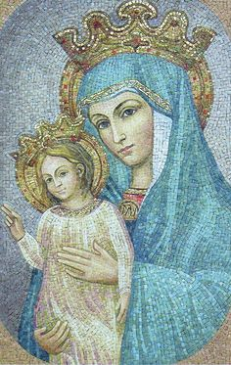
Regina Caeli
Queen of Heaven, rejoice. Alleluia!
For he whom you were made worthy to bear. Alleluia!
Has risen as he said. Alleluia!
Pray for us to our God. Alleluia!
Rejoice and be glad, O Virgin Mary. Alleluia!
For the Lord has risen indeed. Alleluia!
Let us pray;
God, who through the resurrection of your Son, our Lord Jesus Christ,
has made glad the whole world, grant us, we pray,
that through the intercession of the Virgin Mary, his mother,
we may attain the joys of everlasting life.
Through the same Christ our Lord.
Amen.

Slide 3
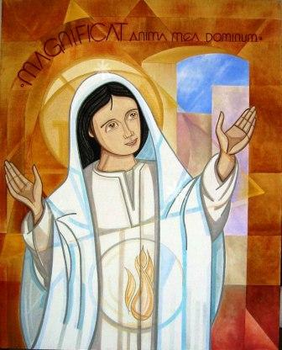
The Magnificat
My soul glorifies the Lord,
My spirit rejoices in God, my Saviour.
He looks on his servant in her loneliness;
henceforth all ages will call me blessed.
The Almighty works marvels for me.
Holy his name!
His mercy is from age to age,
on those who fear him.

Slide 4
He puts forth his arm in strength
and scatters the proud-hearted.
He casts the mighty from their thrones
and raises the lowly.
He fills the starving with good things,
sends the rich away empty.
He protects Israel, his servant,
remembering his mercy,
the mercy promised to our fathers,
to Abraham and his sons for ever. Amen.

Slide 5
The glorious Mysteries
The Resurrection
The Ascension
The Decent of the Holy Spirit
The Assumption
The Crowning of Our Lady Queen of Heaven

Slide 6
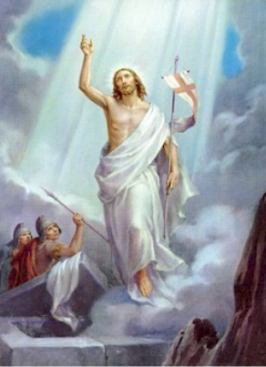
The Resurrection
John 20: 1
The Glorious Mysteries
Hail Mary, full of grace.
Our Lord is with thee.
Blessed art thou among women,
and blessed is the fruit of thy womb,
Jesus.
Holy Mary, Mother of God,
pray for us sinners,
now and at the hour of our death.
Amen.
Faith

Slide 7
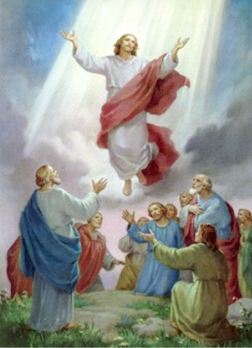
The Ascension
Luke 24: 31
The Glorious Mysteries
Hail Mary, full of grace.
Our Lord is with thee.
Blessed art thou among women,
and blessed is the fruit of thy womb,
Jesus.
Holy Mary, Mother of God,
pray for us sinners,
now and at the hour of our death.
Amen.
Christian Hope

Slide 8
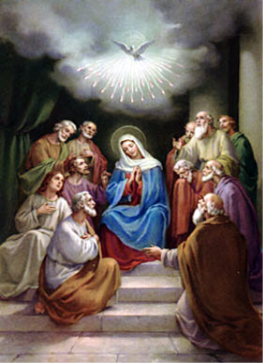
The Decent of the Holy Spirit
Acts of the Apostles 2: 1
The Glorious Mysteries
Hail Mary, full of grace.
Our Lord is with thee.
Blessed art thou among women,
and blessed is the fruit of thy womb,
Jesus.
Holy Mary, Mother of God,
pray for us sinners,
now and at the hour of our death.
Amen.
Gifts of the Holy Spirit

Slide 9
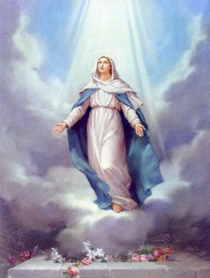
The Assumption
John 14: 3
The Glorious Mysteries
Hail Mary, full of grace.
Our Lord is with thee.
Blessed art thou among women,
and blessed is the fruit of thy womb,
Jesus.
Holy Mary, Mother of God,
pray for us sinners,
now and at the hour of our death.
Amen.
To Jesus through Mary

Slide 10
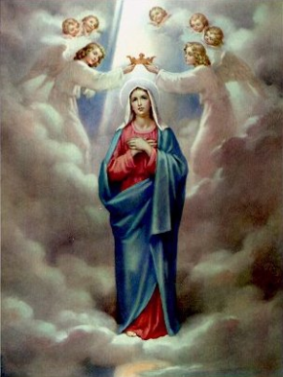
The Crowning of Our Lady Queen of Heaven
Revelation 12: 1
The Glorious Mysteries
Hail Mary, full of grace.
Our Lord is with thee.
Blessed art thou among women,
and blessed is the fruit of thy womb,
Jesus.
Holy Mary, Mother of God,
pray for us sinners,
now and at the hour of our death.
Amen.
Grace of Final Perseverance

Slide 11
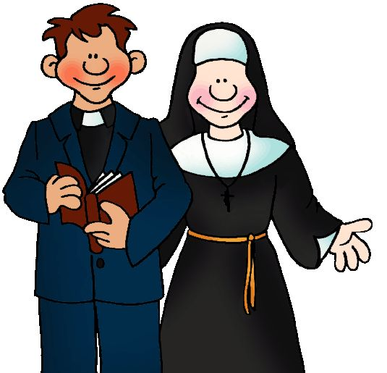
Diocesan Prayer for Vocations
Lord Jesus, send labourers into your harvest.
Inspire, in the hearts of your people,
vocations to the priesthood and religious life.
Bless our families with a spirit of generosity.
May those whom you call to the priesthood and religious life
have the courage to give themselves to your Church
as co-operators in your work.
St. John Vianney: Pray for us

